Slide 1
IBM University Engagement Project Submission
“Exploring the Power of Agentic AI with IBM Granite and LangFlow”

Slide 2

Project Tile – Predictive Maintenance of Industrial Machinery
Domain of Project – AI/ML-Based Predictive Maintenance for Industrial Machinery
Student Name | Recent Passport Photo | Email ID | Mobile number [WhatsApp]
Samarth Iranna Kurle |  | samarthkurle@gmail.com | 7276085941

Slide 3
Problem Statement -
Problem Statement : Predictive Maintenance of Industrial Machinery
The Challenge
Industrial machines can fail unexpectedly due to wear, overheating, vibration, excessive load, and component degradation. Unexpected failures lead to production downtime, high maintenance costs, equipment damage, and safety risks
The Objective
The main objective of this project is to develop an AI-based Predictive Maintenance System that uses machine learning to predict industrial machine failures before they occur.
To collect and analyze machine operating data.
To identify important factors responsible for machine failure.
To predict whether a machine is likely to fail.
To classify the type of machine failure.
To provide early warnings and maintenance alerts.
To reduce unexpected machine downtime.
To minimize maintenance and operational costs.
To improve machine reliability, safety, and overall productivity.
To provide an interactive dashboard for real-time monitoring, prediction, and visualization using IBM Cloud and AI tools.

Slide 4
Proposed Solution -
Proposed Solution:
We propose an AI-powered Predictive Maintenance System that uses Machine Learning and IBM Cloud/AI tools to analyze industrial machine data and predict failures before they occur.
Data Collection: Collect machine parameters such as temperature, rotational speed, torque, tool wear, and machine type.
Data Processing: Clean, preprocess, and analyze the machine dataset to identify important patterns.
AI/ML Prediction: Train a machine learning model to predict machine failure and failure type.
Risk Detection: Calculate the machine's risk level as Low, Medium, or High.
Early Alerts: Generate maintenance alerts when abnormal operating conditions or possible failures are detected.
Interactive Dashboard: Display machine health, predictions, failure statistics, and important parameters through an attractive dashboard.
IBM Cloud Integration: Use IBM Cloud/AI services for model deployment, data analysis, visualization, and scalable processing.
Maintenance Recommendations: Provide actionable recommendations such as inspection, servicing, or component replacement.
Expected Benefit: Reduce unplanned downtime, maintenance cost, equipment damage, and production losses while improving machine reliability and productivity.

Slide 5
Technology Used
Programming Language: Python
Machine Learning: Scikit-learn
Data Processing: Pandas, NumPy
Data Visualization: Matplotlib, Plotly
Frontend: Streamlit
Backend: Python / Flask
AI Platform: IBM watsonx.ai
Cloud Platform: IBM Cloud
AI Development Assistant: IBM Bob – used for AI-assisted coding, project development, debugging, code generation, and improving the application architecture
Cloud Storage: IBM Cloud Object Storage
Model Deployment: IBM Cloud / watsonx.ai
Dataset: Kaggle Predictive Maintenance Dataset
Version Control: GitHub
Dashboard: Streamlit interactive dashboard
ML Algorithms: Random Forest, Decision Tree, Logistic Regression, etc.

Slide 6
Langflow component Used -
Chat Input – Receives user queries about machine health and failures.
Prompt Template – Creates structured prompts for the AI model.
IBM watsonx.ai / LLM Component – Processes machine information and generates AI-based insights.
Python Component – Performs data processing, calculations, and predictive-maintenance logic.
Data Loader – Loads the predictive-maintenance dataset.
Data Transformation Component – Cleans and prepares machine data.
Machine Learning Model Component – Connects the trained failure-prediction model.
Conditional Router / If-Else – Routes machines according to risk level.
Output Parser – Converts AI output into structured results.
Chat Output – Displays the prediction and maintenance recommendation.
API Request Component – Connects Langflow with the Streamlit/IBM Cloud application.

Slide 7
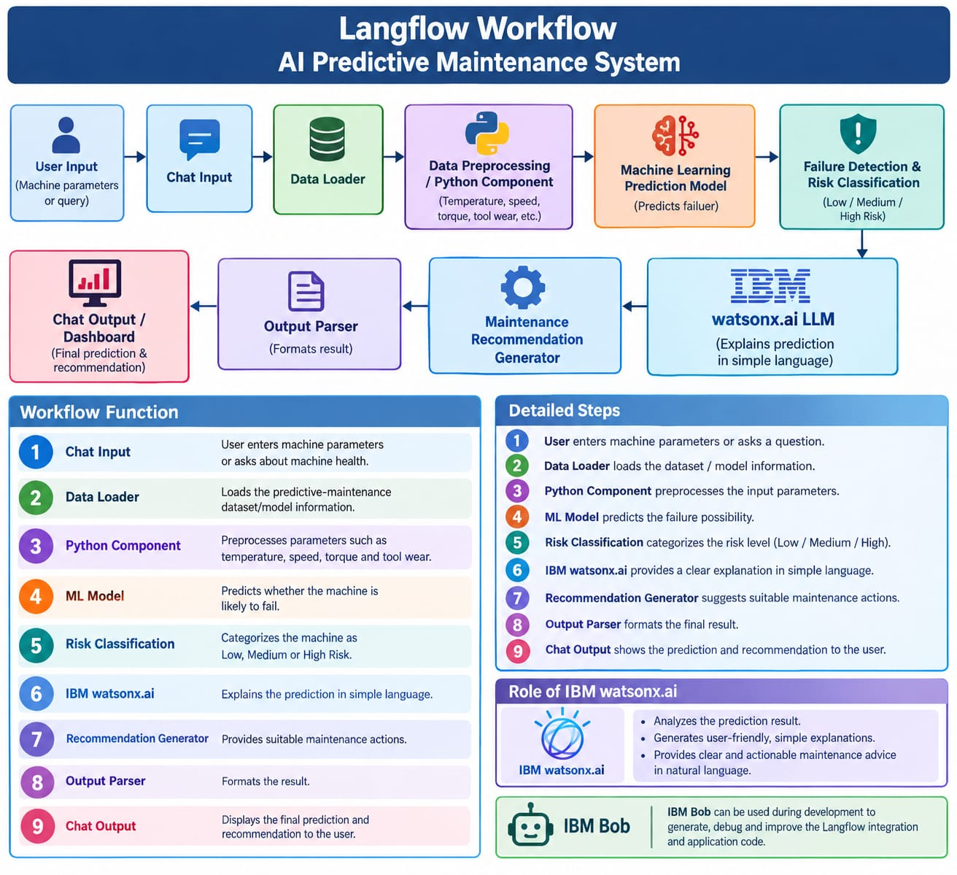
Langflow workflow -

Slide 8
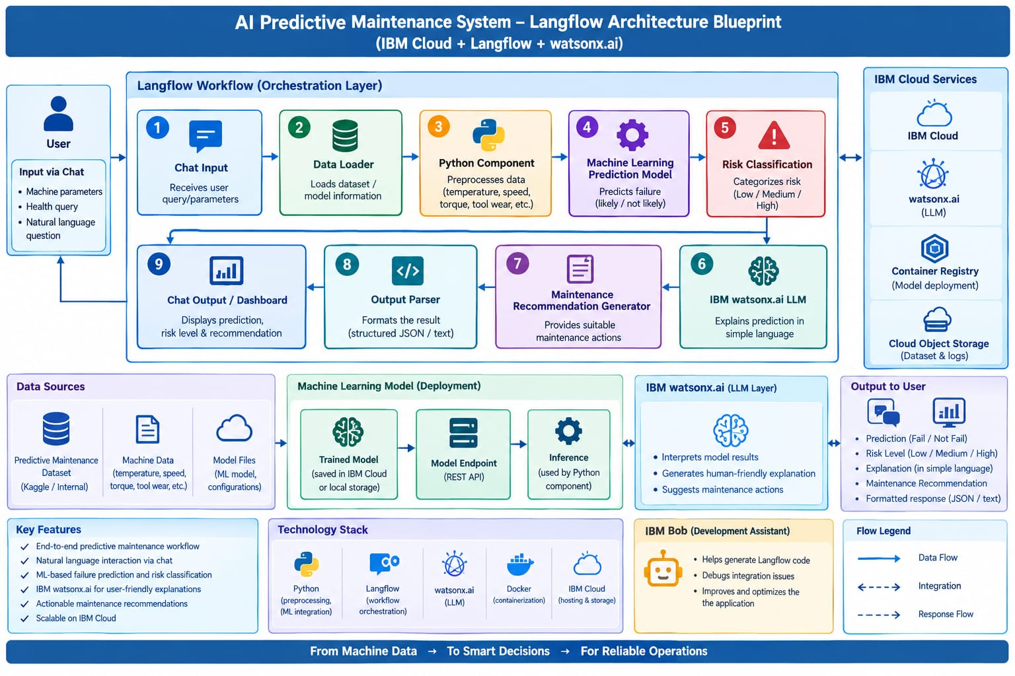
Architecture blueprint

Slide 9

Role of Agentic AI in the solution
Agentic AI acts as an intelligent decision-making layer in the AI Predictive Maintenance System. Instead of only predicting machine failure, it can analyze the prediction, determine the required action, and assist in taking the next step.
Key Roles:
Continuous Monitoring: Monitors machine parameters and detects abnormal conditions.
Failure Prediction: Uses ML predictions to identify possible machine failures.
Risk Assessment: Automatically classifies machine health as Low, Medium, or High Risk.
Root-Cause Analysis: Analyzes sensor patterns to identify possible reasons for failure.
Intelligent Decision Making: Determines whether inspection, servicing, or component replacement may be required.
Automated Alerts: Generates maintenance alerts when high-risk conditions are detected.
Maintenance Recommendations: Uses IBM watsonx.ai to generate understandable maintenance recommendations.
Data-Based Learning: Uses historical machine data and previous failures to improve future decisions.
Human Assistance: Provides engineers with AI-generated insights while keeping the final maintenance decision with the human expert.
IBM Bob Integration: Supports developers by assisting with code generation, debugging, workflow development, and integration.

Slide 10


Token Usage
11,761 token are used
Before Prompt
After the Prompt
·
·
·

Slide 11
Novelty and Uniqueness
The proposed AI-Based Predictive Maintenance System is unique because it combines Machine Learning, Agentic AI, Langflow, IBM watsonx.ai, IBM Cloud, and IBM Bob into a single intelligent maintenance solution.
AI-Based Early Failure Prediction: Predicts machine failure before breakdown occurs.
Agentic AI Decision Support: Goes beyond prediction by analyzing risks and suggesting appropriate maintenance actions.
Multi-Level Risk Detection: Classifies machine condition into Low, Medium, and High Risk.
Explainable AI Recommendations: Provides understandable reasons and maintenance recommendations instead of only giving a failure result.
Langflow AI Workflow: Connects data processing, ML prediction, AI reasoning, and recommendations through a visual workflow.
IBM Cloud Integration: Provides a scalable environment for storing, processing, deploying, and monitoring the AI solution.
IBM watsonx.ai Integration: Enables intelligent analysis and natural-language maintenance insights.
IBM Bob-Assisted Development: Accelerates application development, debugging, code generation, and AI workflow integration.
Interactive Dashboard: Provides machine-health status, failure probability, risk level, historical trends, and maintenance recommendations in one interface.
Proactive Maintenance: Helps shift industries from reactive maintenance to predictive and condition-based maintenance.
Scalable Architecture: The system can be extended to multiple machines, factories, sensors, and industrial environments.

Slide 12
Git Hub Link
https://github.com/Samarthk22/predictive-maintenance-industrial-machinery.git
·
·
·

Slide 13
Future Scope
The AI-Based Predictive Maintenance System can be further enhanced and deployed for real-world industrial applications.
IoT Sensor Integration: Connect real-time sensors for temperature, vibration, pressure, speed, and torque monitoring.
Real-Time Prediction: Provide continuous machine-health monitoring and instant failure prediction.
Advanced AI Models: Use Deep Learning, LSTM, Transformers, and advanced time-series models for higher prediction accuracy.
Remaining Useful Life (RUL): Predict the remaining operating life of machine components.
Digital Twin Integration: Develop a digital twin of industrial machines for virtual monitoring and failure simulation.
Autonomous Agentic AI: Enable AI agents to automatically analyze failures, prioritize maintenance tasks, and generate work orders.
Computer Vision: Use cameras to detect cracks, wear, corrosion, overheating, and other visible defects.
Mobile Application: Develop an Android/iOS application for maintenance engineers and plant managers.
·
·
·

Slide 14
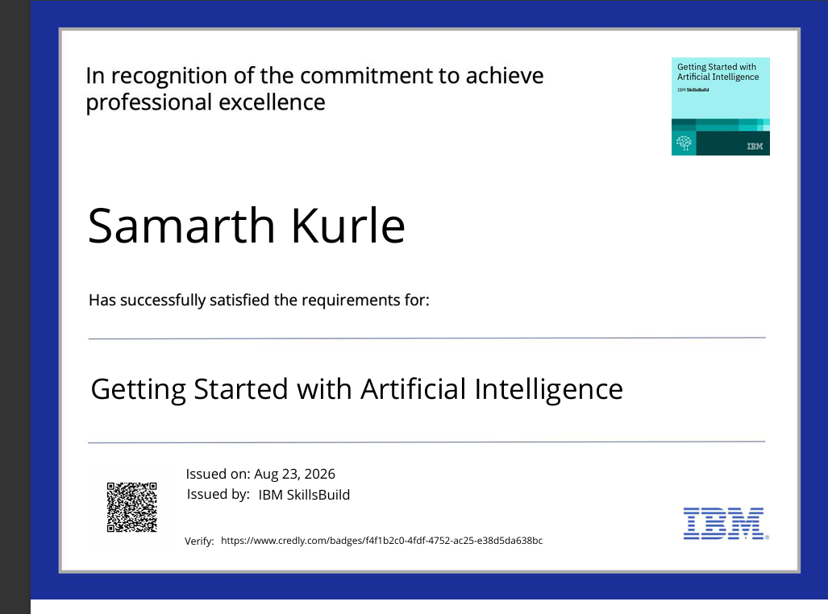
Certificates Earned:
Please add your credly certificate

Slide 15
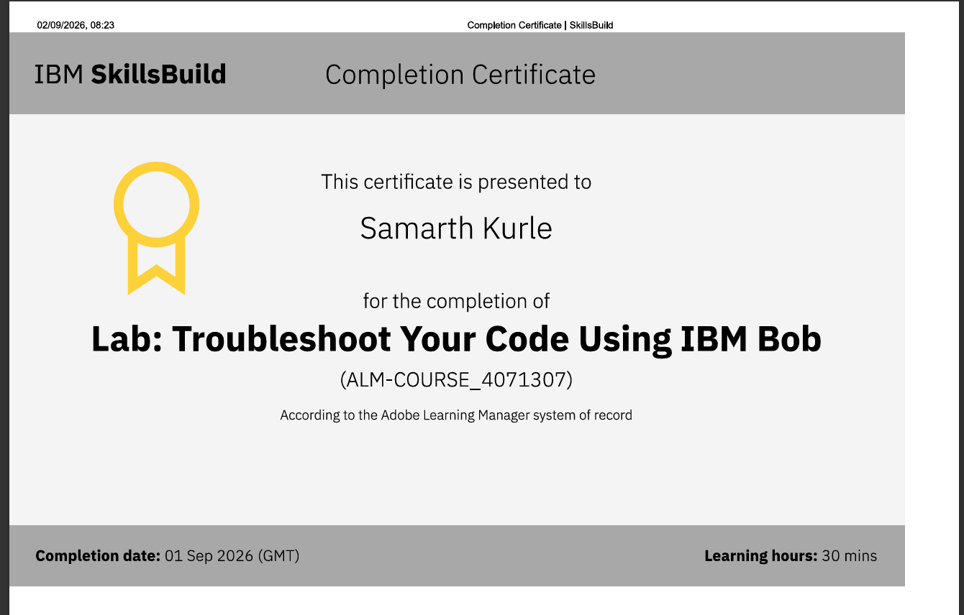
Certificates Earned:​
Add your IBM BOB Certificate

Slide 16


